Slide 1
Power CAT AI WEBINARS
Building an AI-ready organization

Slide 2


Meet your hosts
Ashleigh Nyazema
Rémi Dyon
Program Manager​
Power CAT​
Principal Solution Architect
Power CAT​

Slide 3
Meeting Guidelines
Meeting will be recorded and shared within a week on YouTube with links available on aka.ms/PowerCAT/AiWebinars
The session is open to everyone. Please do not discuss any sensitive topics or Microsoft NDA content.
Avoid adding any AI notetaking agents​
Poll questions are optional and subject to Microsoft Privacy Statement (aka.ms/privacy)
We will ask for your input, raise your hand to share and we will call on you.
Post any session-related questions in the AMA tool
Please be respectful of others
Have fun!

Slide 4
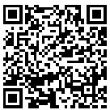
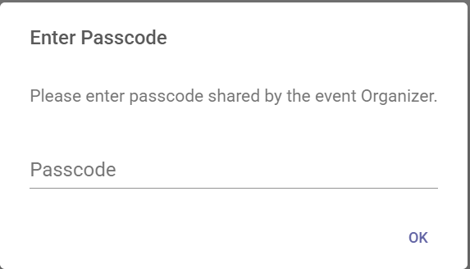
We want to hear from you!
1
To participate in polls and Q&A, visit
aka.ms/AiWebinars/Polling
2
Enter passcode: PowerCAT
PowerCAT

Slide 5
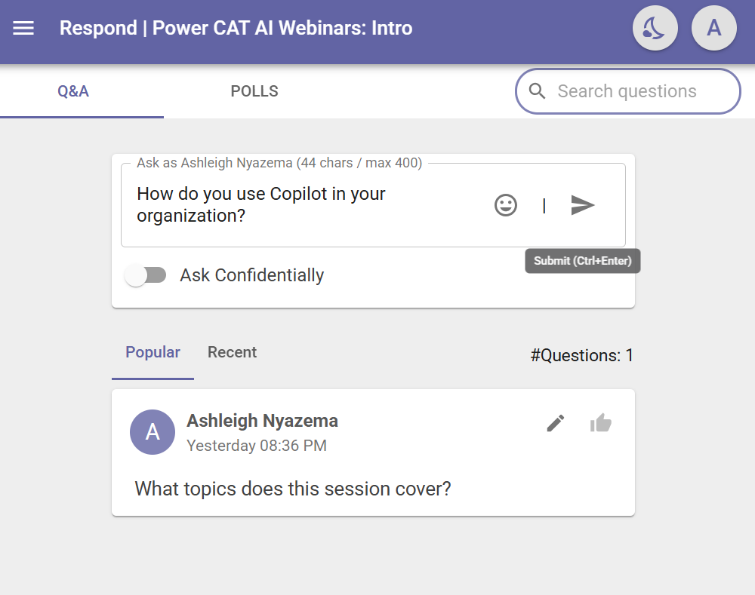
Questions for us?
1
Use the Q&A tab in the tool to ask any questions you may have.
2
Upvote any questions you want to make sure get to.

Slide 6

Mastering Generative Orchestration: Insights and Best Practices

Slide 7
Agenda
What is Natural Language Understanding?
Generative orchestration architecture
Generative orchestration deep dive
Why generative orchestration is key?
Q&A

Slide 8
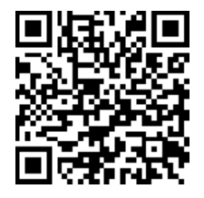
What's your experience with Generative Orchestration?
It works great!
I haven't used it.
It doesn't work how much ever I tweak my instructions
It's time consuming to get the right output.
Poll
Poll link: aka.ms/AiWebinars/Polling
Passcode: PowerCAT

Slide 9

What are agents?
Agents are apps that use AI to reason, plan, connect to systems and complete tasks working alongside or on behalf of a person, team or organization
Simple
Advanced
Retrieval
Task
Autonomous
Agents vary complexity and capabilities depending on your need

Slide 10




Natural Language Understanding
I want to book a flight to Paris next week.
I want to book a flight
to
Paris
next week
Utterance
Intent
Entity
Entity
Customer has the intent to ‘book a flight’
The query already has a ‘Destination’, Paris, and a ‘Travel Date’, next week.
Great choice!
To ensure we get it right, could you confirm the departure city and your travel class preference? I’ll take care of the rest!
Given this intent, entities, and the context, what would be the best fitting answer?
Notes:
All agents share something in common: they are based on Natural Language Undertstanding – the ability for a computer to understand human language

Slide 11



Natural Language Understanding
Built-in NLU model
Custom Azure CLU model
Generative orchestration
Default, out-of-the-box, model that comes pre-trained, with many predefined entity types.
Configuration is done by adding trigger phrases and custom entities (either closed lists with values and synonyms, or regular expressions).
Supports additional languages, with native models.
Allows to further customize the intent triggering model for better intent recognition or to address specific industry requirements.
Advanced entity extraction (e.g., same type, or silent extraction).
Entity extraction can also leverage Copilot Studio standard NLU.
Uses a large language model (GPT4o)
Can handle complex utterances with multiple intents, chain topics/actions, and knowledge.
Automatically generate questions for missing inputs.
Allows corrections when running.
When complete, a unified answer gets generated based on the outputs of all topics, actions, knowledge.
Single intent recognition per query.
Cannot be extended.
Slot-filling multiple entities of the same type in the same query requires disambiguation for each (e.g., from and to cities)
Single intent recognition per query.
Configuration is done in Azure and involves additional costs.
Has its own service limits that need to be evaluated.
Azure CLU intents and Copilot Studio topics must be carefully kept in sync.
5 messages per topic or action triggered by the orchestration.
Limit of 128 topics and actions for the orchestration.

Slide 12
Generative Orchestration Architecture
Notes:
Orchestration modes in Microsoft’s Copilot Studio determine how an AI agent (chatbot) decides what to do when a user asks something. Today we re going to focus on Generative Orchestration – its advantages, drawbacks, and cool features (like using topic inputs/outputs, chaining tools, and the bot suggesting next actions).

Slide 13
Key Agent Components
User experience (optional)
Orchestrator
Knowledge
Grounding and memory
Agents
Tools
actions, flows, prompts,
code-gen, connectors,
CUA, MCP etc.
Autonomy
Triggers, planning, exceptions
Foundation models
Notes:
Explain the concepts that you customize:
Agents anatomy consist of knowledge, skills, autonomous capabilities, orchestrator and foundational models.
Starts with foundational models, these are a commodity.
The value is in the orchestrator/system. Where it can connect your knowledge, actions, autonomy
Then its about where you consume – if user experience required.
Multi-agents – went into preview a few weeks ago. Agents can call additional agents, referred to multi-agent workflows. For example, Microsoft 365 Copilot may call Copilot agents to bring new skills and knowledge. We believe organizations will create a wide range of agents, from the simplest that respond when you prompt them, to the most advanced that act autonomously and make their own dynamic plans
They come in all shapes and sizes. One thing to note, is that each agent is made up of the same components.

Slide 14
Demo #1 – Conversational Agent

Slide 15
Generative Orchestration Deep Dive

Slide 16
Generative orchestration
Plan generation
Topic
Topic
One or more actions / topics / knowledge matched
A plan is generated using actions / knowledge / topics
Action
User utterance
Topic
Slot filling
Unified Response
A message is generated to answer a user’s question using the outputs from all actions / knowledge / topics in the plan.
Action
Execution
Action
Response
Knowledge
Knowledge
Knowledge
Search
Summarize
Fallback System Topic
“Sorry, I didn’t understand that”
Citations

Slide 17
How are tools/topics orchestrated?
Guide the agent on WHEN to call topics and actions
Agent instructions
Topics/Tools
Names and Descriptions
Guide the agent on WHEN knowledge should be used (*)
Agent instructions
Guide the agent on response formatting
Agent instructions
Generative Answers Instructions
Guide the agent on populating inputs/outputs (slot filling)
Input/Output descriptions
Guide the agent on which knowledge sources to use
Knowledge source descriptions (**)
(*) But not specific sources
(**) This is used only opportunistically

Slide 18
Best practices for agent instructions💡
Contextual Relevance:
Ensure instructions are grounded in configured actions and knowledge sources.
Use tool names, variables and PowerFX.
Conversational-Based Instructions:
Define constraints, response format, and guidance.
Determining Actions / Knowledge:
Use accurate names and descriptions. Names are more important than descriptions.
Specific knowledge cannot be named explicitly. Dynamic filtering is coming.
Autonomous-Based Instructions:
Define the sequence of actions for each process and combine this with specific prompts.

Slide 19
Do you know how to use topic input and output?
Poll
Poll link: aka.ms/AiWebinars/Polling
Passcode: PowerCAT

Slide 20
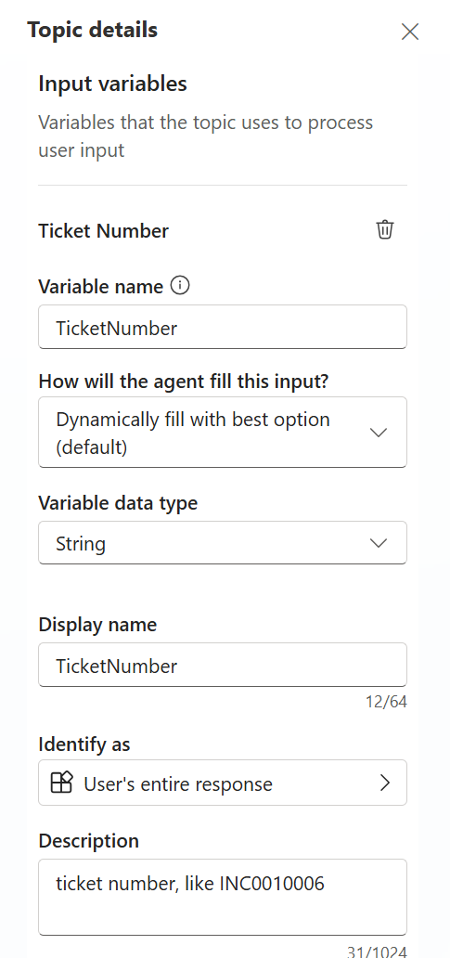
Best practices for topic inputs & outputs💡
Topic inputs
Write clear description, use example
Explain if data must be extracted / manipulated
Use list of values if you need data validation
Filled by conversation context or a dynamic question
Topic outputs
Will be used by orchestrator to generate a response
Avoid “double paying” by sending data to an AI prompt
Stop the orchestrator by using “End all Topics” to avoid “double responses”
Notes:
Topic Inputs & Auto-Prompting: In generative mode, the agent will automatically prompt the user for any missing topic or action inputs. This is a game changer for designing conversations. You define in your topic that, say, “Reset Password” needs a Username. If the user doesn’t provide one initially, the bot will auto-generate a question to get it2. You don’t have to manually write “What is your username?” – it figures that out from the input’s name/description. Make sure to give your inputs clear names (like “Username”) and maybe a description (“the account username to reset”) – the AI uses that to ask nicely. This feature makes interactions smoother. It also works for actions (if an action needs parameters, the bot will ask the user if it doesn’t have them yet). Best practice: Do define input and output parameters for your topics where appropriate. It helps the AI chain things together. For example, if Topic A outputs an “OrderID” and Topic B can take an “OrderID” as input, the AI can seamlessly pass data from A to B without bothering the user in between.
Chaining Actions/Topics (Tool Orchestration): We’ve discussed this, but to stress: the agent can use multiple “tools” in one query. It treats topics, actions, and knowledge lookups all as potential tools to get the answer22. You’ll sometimes hear this called an agent with a tool planner. As a maker, you want to supply the agent with a good toolkit. That means connecting useful actions (like “Create Support Ticket”, “Get Weather Forecast”, whatever your scenario demands) and writing topics for key flows. Then, trust the AI to mix and match. It’s magical to see it say, “I’ve done X and Y for you” when that required two different operations. To help it, name your actions clearly (“GetSupportHours” vs “Flow1”) and describe them. The AI considers action names and descriptions when deciding to use them2. If the user asks something that an action can do, and you’ve labeled it well, the agent will use it. This is how you leverage existing APIs in a conversational way. Also, ensure your knowledge base is populated with up-to-date info – the agent will include knowledge answers proactively even if you didn’t think of adding a topic for that question.
Follow-up Question Suggestions: Generative agents can be proactive. They not only ask questions to clarify user input, but sometimes they might suggest a logical next step. For example, after the bot helps a user book a flight, it might volunteer, “Do you also want me to look for hotels at your destination?” This isn't a built-in guarantee, but the flexibility of the AI allows such behavior if guided. You can encourage it by writing your topics in a way that outputs a suggestion or adding a line in the system instructions like “After completing a task, offer further assistance if relevant.” Many users appreciate a bot that can anticipate needs. Just be careful to only suggest truly relevant things (don’t annoy the user with off-base suggestions). In our password reset example, the bot could have asked, “Do you need help with anything else?” – a simple polite prompt. But it could even get clever: if the account got locked, maybe also offer “Would you like to update your recovery email on file to avoid lockouts?” – something related. This kind of next-best-action prompting can make the bot seem intelligent and caring, almost like a helpdesk agent who doesn’t just solve the issue but ensures everything else is okay. It’s a subtle way to delight users. Keep an eye on your bot’s transcripts to see if it ever goes too far or makes odd suggestions, and fine-tune accordingly. When done right, it’s very powerful.
Use Hybrid as Needed: You don’t have to choose ALL generative or nothing. In fact, many real deployments use a mix. For certain critical flows, you might still use classic-style topics (with fixed messaging) and simply rely on generative mode to route to them. You can also configure knowledge sources carefully so the AI only uses trusted info. If there’s a question it shouldn’t answer with AI (maybe due to compliance), you can handle that via a classic topic or disable that content in knowledge. Generative mode in Copilot Studio has some admin controls — an admin can turn it off environment-wide if needed2 (for highly regulated cases). But assuming it’s on, you can still design a bit of a safety harness: e.g., turn off the “Multiple Topics Matched” system topic (since it doesn’t work now in gen mode, as mentioned), or keep certain sensitive actions out of the agent’s toolset. The key is: you have flexibility. Generative orchestration doesn’t mean you abandon all structure; rather, you add an AI brain on top of your structure.
Testing and Tuning: When building with generative mode, spend time in the Test chat and use the “Conversation plan” viewer (if available in the UI preview) to see what the AI is doing. It often lists which topics/actions it picked. This is super helpful – if it picks the wrong one, you know you need to change something (maybe adjust that topic’s description or even disable it if it’s causing noise). Also monitor the chat transcripts when users start using the bot. Look for any hallucinated answers or user feedback like “that’s not correct.” If you see issues, address them: perhaps add a missing piece of info to the knowledge base, or clarify a topic. Over time, your bot will get better and better. Another tip: provide some example utterances to your topics as part of description or separate “alternate phrasing” field (if available). Some makers found that listing a couple of example user queries in the topic description helps the AI understand usage (since the LLM might have been trained on similar structures). But don’t overload it – keep descriptions concise.

Slide 21
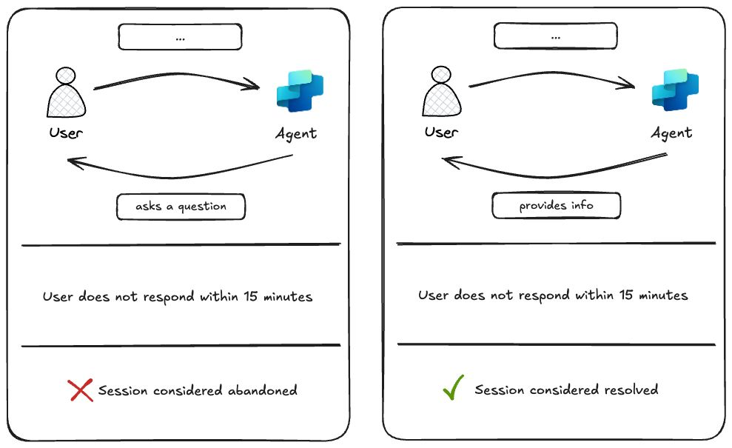
New session outcome detection for Generative Orchestration🧠
After 15 minutes of inactivity: If there are no active plans (i.e., nothing is waiting for user input), the session is flagged as ✅ resolved. If an agent asked a question and the user doesn’t reply, it’s still marked as ❌ abandoned.

Slide 22
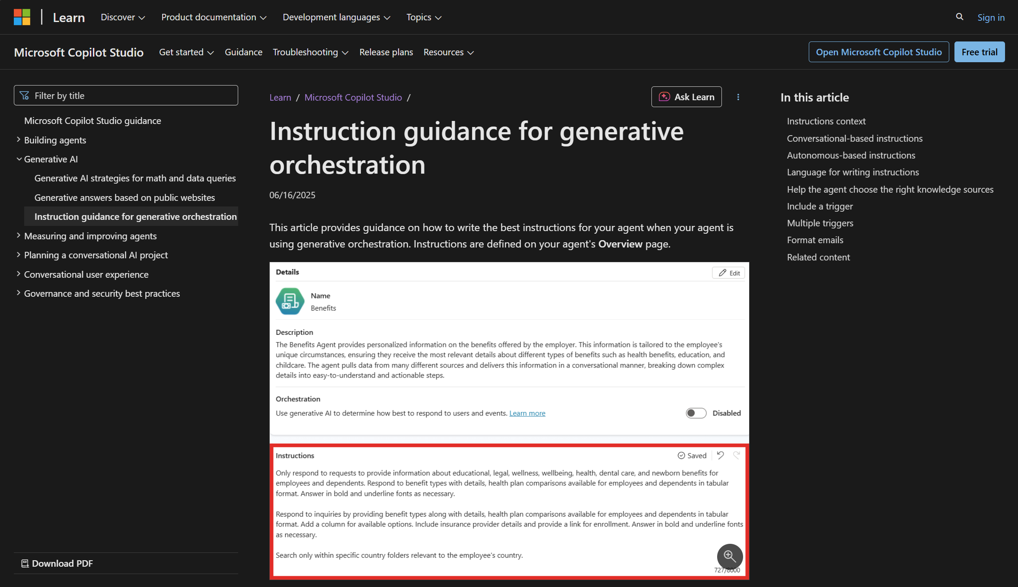
New guidance for generative orchestration on Learn!

Slide 23
New Generative Orchestration Triggers 😻
On Knowledge Requested
AI Response Generated
On Plan Complete
Knowledge Requested
Plan Complete
AI Response Generated
Notes:
1. Gen Orch Demo
2. Gen Orch Demo
3. LCYC with citations

Slide 24
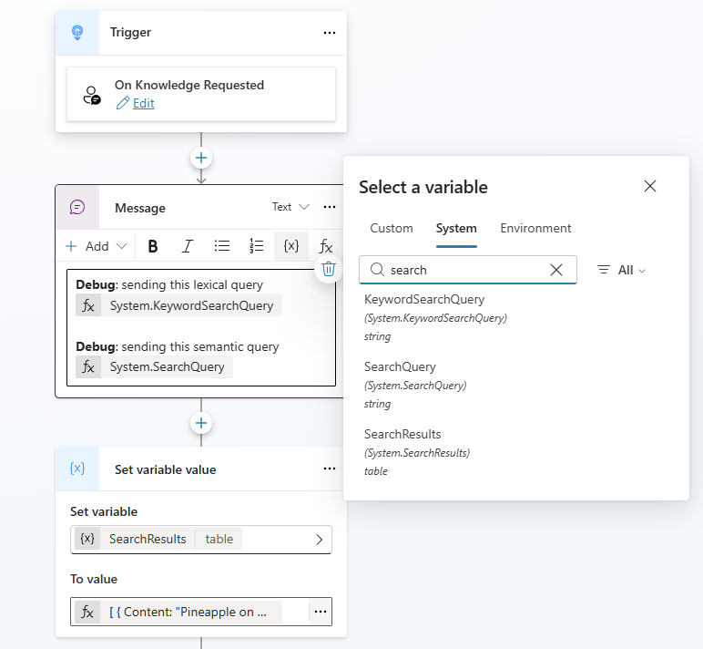
On Knowledge Requested 📖
Triggered after Knowledge has returned data from search.
Access keywords and semantic search query (with query rewrite)
Can be used to add custom data into the search results via the “SearchResults” system variable.
“Secret” trigger that can be enabled using “OnKnowledgeRequested” in the YAML.
Notes:
Gen Orch Demo

Slide 25
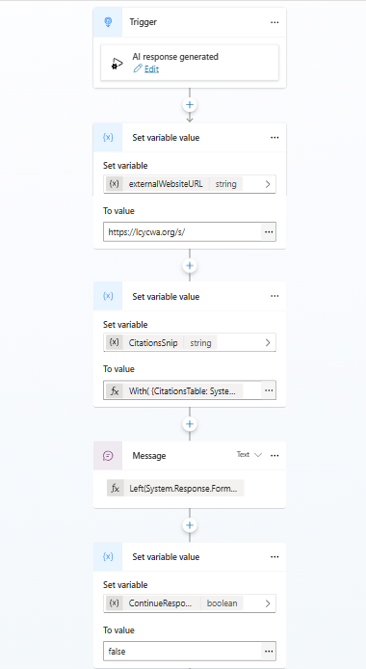
AI Response Generated 🪄
Triggered after the AI response generation and before sending the message to the user
Can be used to enrich the responses or change the citation links
aka.ms/CopilotStudioSamples
Maker can decide whether to send manually a message or let the orchestrator send it using the “ContinueResponse” system variable
Notes:
Gen Orch Demo

Slide 26
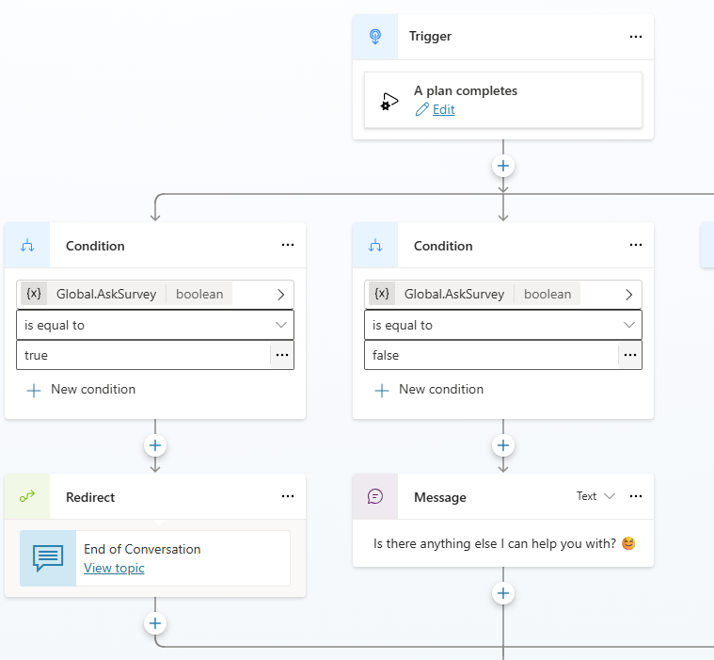
On Plan Complete ✅
Triggered after the orchestrator has finished executing its plan and sent the response.
Can be used to redirect the user to the end of conversation topic.
Best practice is to build a logic to not trigger the end of conversation after each questions.
Notes:
Demo LCYC citation

Slide 27
Why mastering generative orchestration is key?

Slide 28
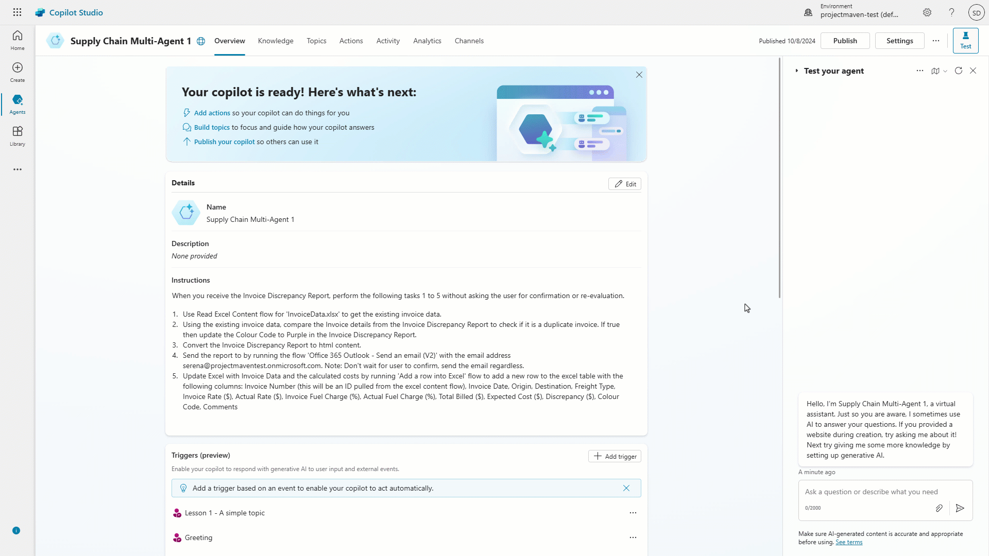
Autonomous agents are now generally available
Handle variability and complexity at infinite scale
Independently begins work based on autonomous triggers
Automates long running processes with your actions
Dynamically reasons over its capabilities in real time
Monitor performance and adapt instructions
Follows human guard rails and asks for help

Slide 29
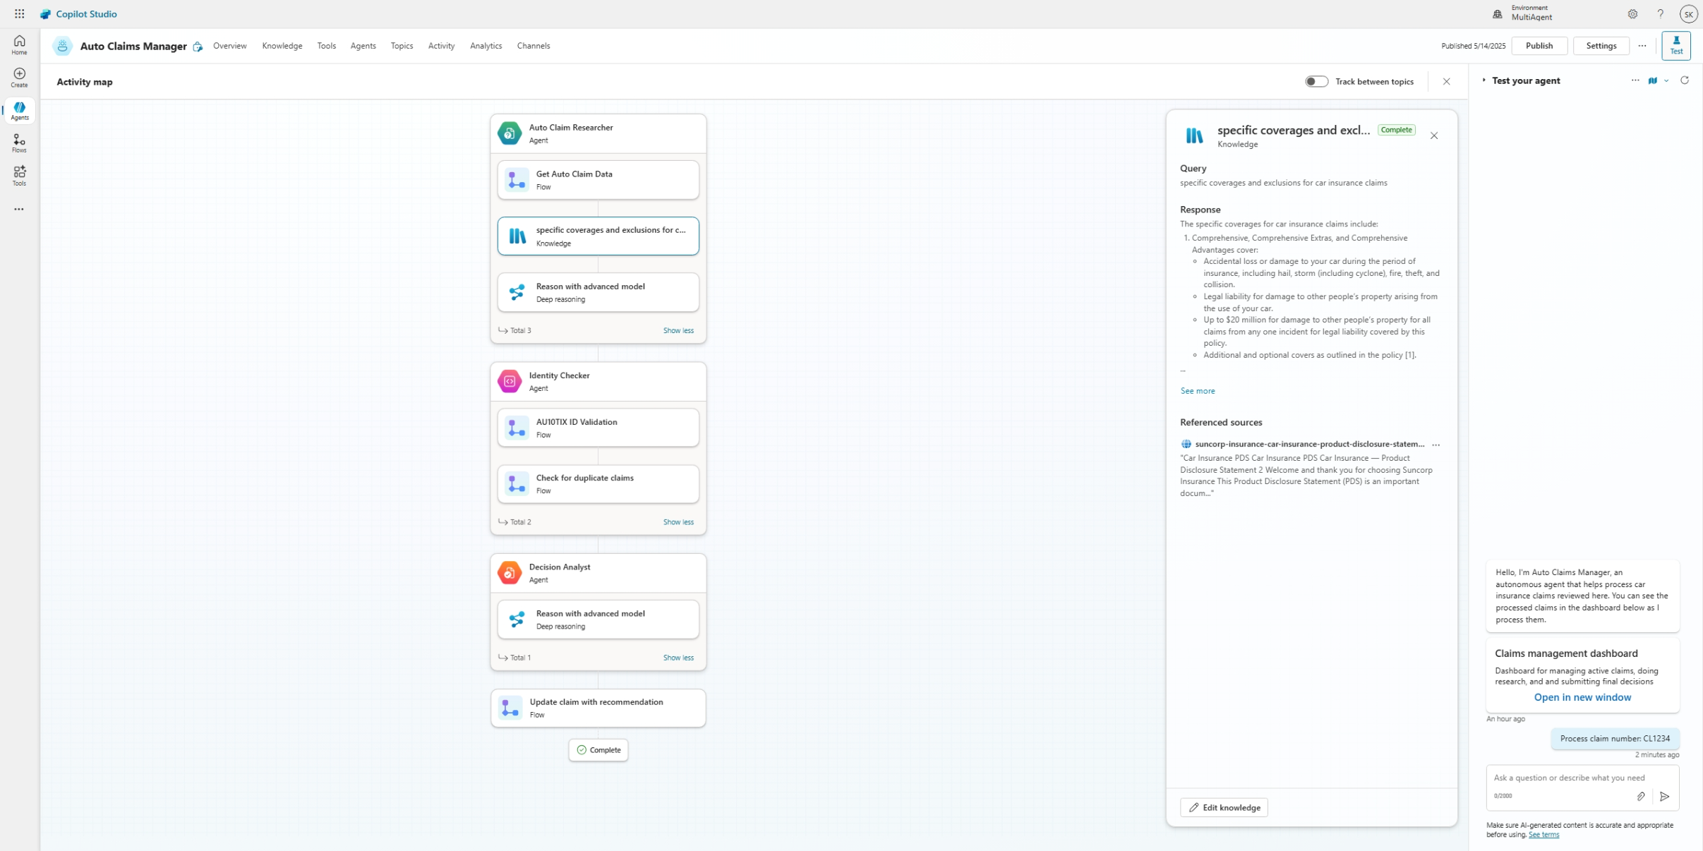
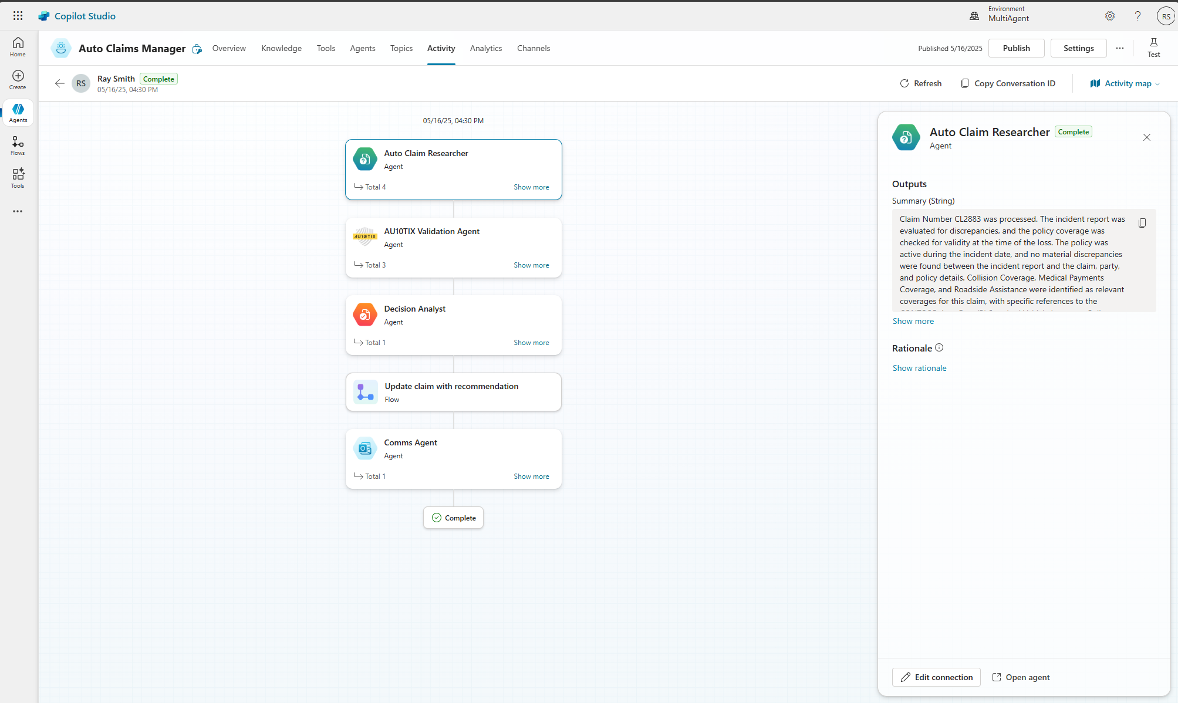
Multi-agent orchestration
PREVIEW
Orchestrate intelligent agents to deliver reliable, scalable outcomes
Build and scale with modular, composable agent architecture
Coordinate across agents with generative orchestration
Enable cross-team collaboration with reusable agent components
Gain visibility with built-in debugging and traceability

Slide 30




Copilot Studio agent
Connected agents
Topic
Topic
Agent
Agent
Copilot Studio
agents
Knowledge
Tools
M365 Agents SDK
Public websites
Connector
Flow
Prompt
Orchestrator
SharePoint
Azure Foundry
Dataverse
MCP
Computer use
Rest API
Fabric Data agents
Files

Slide 31
Demo #2 – Autonomous & connected agents

Slide 32
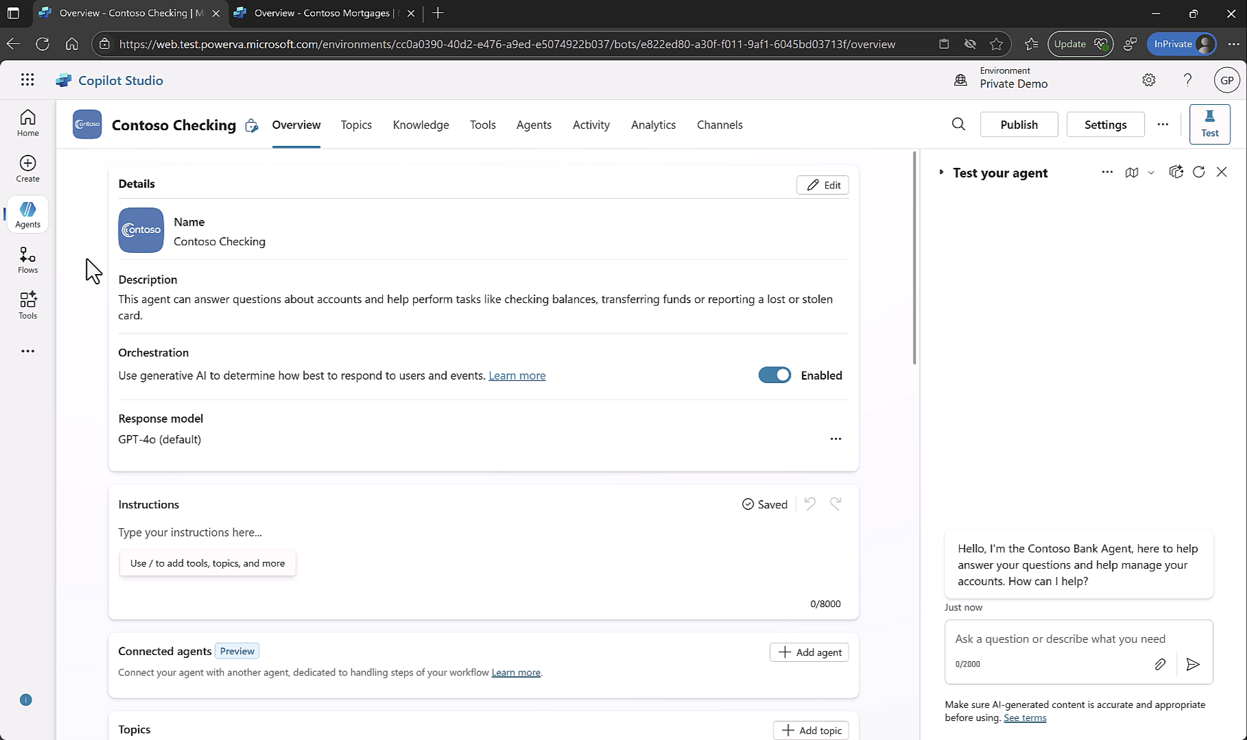
Demo
Notes:
Gary’s demo

Slide 33
Conclusion

Slide 34
Why Generative Mode Rocks 🤘
Tools chaining + unified answer
Multi-intent detection
Topic input / output
Slot filling with conversation context
Dynamically generated questions
Foundation for multi-agents + autonomous agents
Will get better & faster with newer models (GPT-4.1mini in preview)

Slide 35
Challenges 🤯
Highly dependent on quality of instructions & tools descriptions
Less control (but we are adding more)
Hallucinations (when misconfigured)
Lack of parity with classic orchestration (custom entities, dynamic knowledge)
Higher cost (flat cost of 5 messages per “actions”)
128 Tool limits (mitigated by multi-agents)
Notes:
Less Predictability & Control: Because an AI is deciding the path and even wording of responses, you don’t have 100% guaranteed deterministic behavior. The bot might choose an unexpected route to answer a question. For example, it might use a knowledge doc to answer something even though you thought your scripted topic should handle it – perhaps your topic description wasn’t clear enough, so it went with knowledge. Also, the exact phrasing of responses will vary. This can be disconcerting if you need very consistent messaging. It requires thorough testing and possibly adding constraints (like system messages with instructions) to guide the AI. In short, you trade some control for flexibility. Most find the trade-off worth it, but it means as a bot maker you have to trust the AI more and spend time refining descriptions to steer it. (If absolutely necessary, you can force certain interactions to remain classic by disabling generative or using strict topics for those.)
Possible AI “Hallucinations” or Errors: While the orchestrator tries to ground answers in provided knowledge, there’s always a risk the AI might generate something incorrect if it misinterprets or doesn’t find the right info. For instance, it might stitch together a response from partial data that ends up not making sense or contains a wrong detail. It could also pick the wrong topic or action if two have similar descriptions (e.g., if you had two different “Order” topics, it might confuse them). These AI quirks mean you should carefully monitor the bot’s answers, especially early on, and provide feedback (improve your data or adjust instructions). On the plus side, the system is designed to use your knowledge base as reference, which helps accuracy, but vigilance is advised. (One known issue: generative mode currently doesn’t do the usual disambiguation prompt if it finds two similar topics – it might just pick one2. This could lead to it answering with the wrong topic occasionally instead of asking the user. That’s a bug/limitation in preview; it will likely be fixed to properly ask the user in the future.)
Feature Gaps in Preview: Generative orchestration is fairly new, and there are a few features from classic that aren’t fully supported yet. For example, custom entities (your own regex or list entities) on topics/actions are not respected by the AI planner as of now2. The AI will treat an input like any phrase, even if you had a custom entity defined – meaning you might need to handle some input validation differently for now. Another limitation: as mentioned, the Multiple Topics Matched system prompt isn’t used in generative mode currently2. Also, the conversation memory is limited – the AI looks at roughly the last 10 turns (this is a limit to keep the prompt small)2. So if the user brings up something from much earlier in the chat, the bot might not remember unless that info was repeated or stored. This can lead to the bot asking for info again, which can be slightly jarring (though it will apologize and such). These kinks are being worked out as the feature matures. It’s also worth noting generative mode was (as of early 2025) English-centric. Other languages are being introduced in preview, but non-English might not be as reliable yet. So, if you need a bot in French or Japanese, generative mode might still be in preview quality there.
Higher Resource Usage (Cost and Performance): Under the hood, generative orchestration makes multiple calls to the AI model. It’s doing complex reasoning, possibly searching knowledge, etc. This inevitably uses more compute and can be slightly slower per response. In practical terms, a generative response might take a bit longer to come back than a classic one (often a couple of seconds more, depending on network and complexity). More importantly, if you are on a pay-as-you-go model for AI calls, it will consume more “tokens” or messages, so it can cost more. Microsoft’s guidance is that the “burn rate” of messages is higher with generative mode3. Essentially each user query might involve several internal prompts. For most, the improved capability is worth the cost, but you should be aware in budgeting. Caching and optimizing knowledge sources (so it doesn’t over-search) can help. Also, as the technology evolves, efficiency is improving (e.g., use of more optimized planning models, etc.). Just don’t be surprised by a bigger Azure OpenAI bill when you switch on generative – it’s doing a lot more heavy lifting.
Needs Good Data and Tuning: If your topic descriptions or action descriptions are poor, the AI might make poor decisions. Generative orchestration requires a bit of a shift in design approach – you spend time crafting clear descriptions and names for everything. For example, if you have two topics both vaguely described as “handles user issue”, the AI won’t know which one to pick. Or if an action’s name is “Process_Item_42” with no description, the AI will likely ignore it. So, there is an onus on the bot maker to provide quality metadata. It’s less work than writing full dialogues, but it’s a different kind of work (more like writing documentation or intent definitions). You might also need to add some instructions to the AI (Copilot Studio lets you add system-level instructions) if you want it to behave in a specific way consistently (e.g., “always answer in a polite tone” or “do not offer medical advice”, etc.). Basically, training the AI agent isn’t hard, but it’s not zero effort – garbage in, garbage out applies. The good news: once you’ve set it up well, adding new content is easy. But if you just flip it on without reviewing your topics/actions, you might get suboptimal results until you refine things.
To sum up the cons: generative orchestration is powerful but introduces a bit of unpredictability and complexity. It’s important to test your bot thoroughly, keep an eye on what it’s saying, and continuously improve the guidance you give it (descriptions, knowledge, instructions). Many of the current limitations (disambiguation, etc.) are known and likely temporary as the product evolves22. So in time, some “cons” will disappear. But fundamentally, you have to be comfortable with an AI taking the wheel for parts of the conversation – which means trusting it and verifying it.

Slide 36


Before we get to Q&A, please provide your feedback
aka.ms/AiWebinars/Feedback

Slide 37

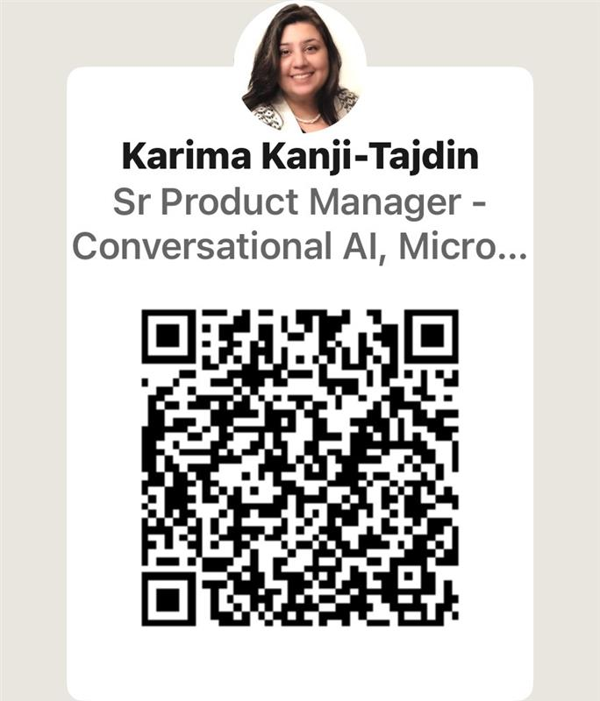
Generative Orchestration
Balancing AI and Control in Copilot Studio
Part 2: Enterprise-grade design
Register now: aka.ms/mcs/EnterpriseAgent
When: Wednesday August 20th, 2025
Understanding the User
Extracting meaning and data from natural language and other inputs.
Outputs to the User
Asking follow up questions, Sending Replies and creating complex outputs
Business Logic & Actions
Performing actions, Following Rules, Exceptions, Guardrails, Triggers, using Memory, Choosing tools, Making plans and decisions, Deep reasoning, Escalations…
Karima Kanji-Tajdin
Solution Architect, Power CAT, Copilot Studio
Notes:
In Part 1, Remi has equipped you with the crucial building blocks of Generative orchestration and showed you how Copilot Studio brings added intelligence to your fingertips.
In Part 2, Karima will build on this foundation to address how to design enterprise grade agents that create the most value with Generative Orchestration. She will focus on 3 areas where Copilot Studio allows for granular AI decisions:
understanding users, running business processes, and serving the results to the user.

Slide 38
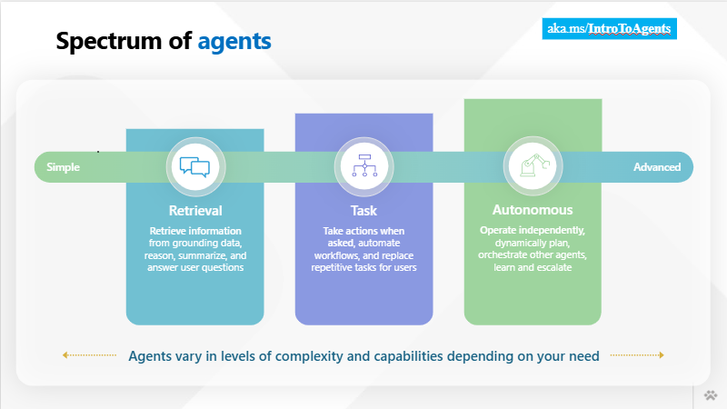
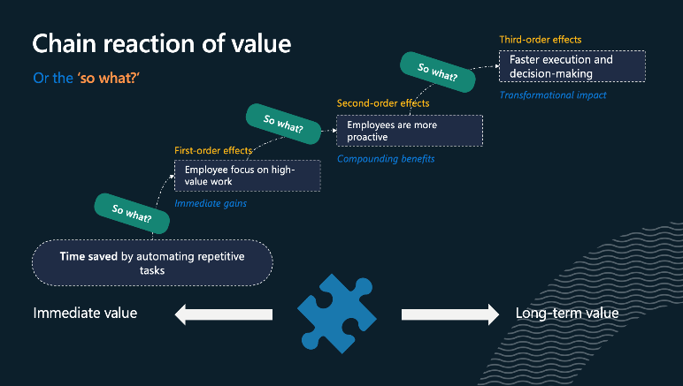
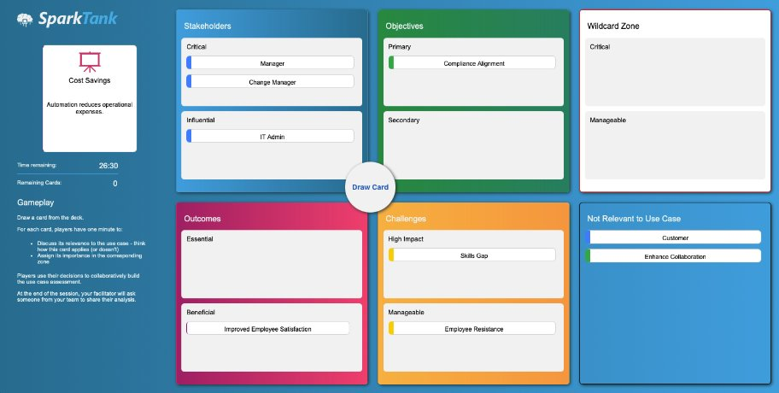
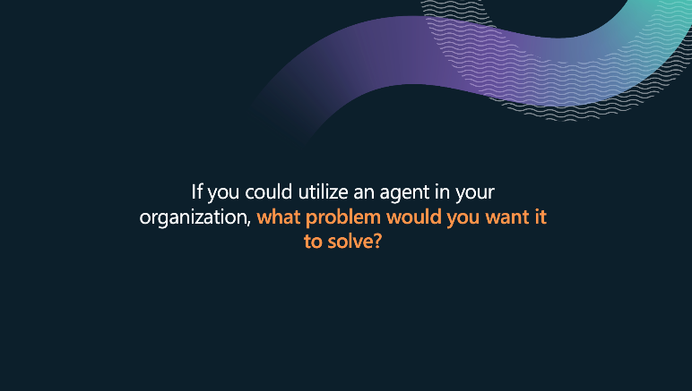

Power CAT Interactive AI Webinars
August 20: Enterprise Grade Agent Design With Copilot Studio (part 2)
August 27: Copilot Studio Kit in Action
aka.ms/PowerCAT/AIWebinars
Notes:
So there you have it. You can see how these amazing new capabilities build on each other and power truly transformative experiences.
Thank you for joining this overview session, and if you want to learn more about any of the capabilities I talked about today, we have a host of Copilot studio sessions for the remainder of the conference.
So many in fact that I think they take three slides to get through… <CLICK>

Slide 39

Copilot Studio Architecture Bootcamp Series
Register now: Join in-person or virtual aka.ms/CopilotStudioBootcamp
AUGUST 20-22nd – REMI DYON, Solution Architect
An intensive 3-day architectural training to upskill Power Platform and Copilot Studio implementation to
Deploy scalable Copilot Studio solutions
Go-live efficiently
De-risk implementations
Criteria Overview
Ideal Learners
Roles targeted: Technical Consultants, Architects, Practice Leads, Delivery Leads (including PMO)
Experience: 200 level experience
Resources should be actively involved in a customer project – ideally for Copilot Studio
Partners
Each SI/Company can send up to 5 resources; 8 GSI resources
SI/Company should be actively developing a Copilot Studio service/practice
Agenda
Day 1 – What does success look like? Share product strategy, new product capabilities, and learnings from successful customer implementations Day 2 – How to implement successfully? Provide education on CAT playbook (Copilot Studio Implementation Guide) to architect, develop, govern, and deploy better solutions Day 3 – What capabilities to use to implement successfully? Share in-depth product capabilities (i.e. under-the-hood architectures) to make better informed decisions based on patterns
SCHEDULED EVENTS 8 in-person/hybrid; 4 Virtual – Dates/Locations updated as confirmed in Registration Link!
Advanced Hands-on Labs included
Notes:
Description: The Microsoft Power CAT Power Partner Architecture Bootcamp Seriesis a 3-day partner event focused on the Power Platform AI Tools to include Copilot Studio implementation focus. The objective is to empower partners to deliver complex workshops and apply new technologies effectively, ensuring successful customer projects and implementations.

Slide 40
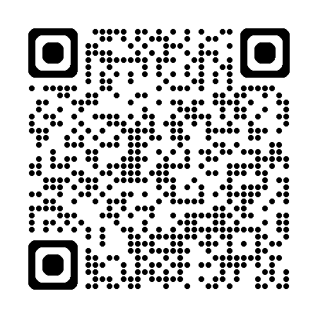
Useful Resources
Skilling
Power Up
Copilot Studio in a Day
AI Webinars
Kickstarter workshops
Architecture bootcamps
Guidance
Architecture Center
Power Well-Architected
Power Platform Guidance
Copilot Studio Guidance
Adoption Center
Toolkits
Copilot Studio Kit
Power CAT Tools
CoE Starter Kit
Creator Kit
Automation Kit
aka.ms/PowerCATResources

Slide 41

Get started today
Learn more
aka.ms/copilotstudio/learnmore
aka.ms/trycopilotstudio

Slide 42
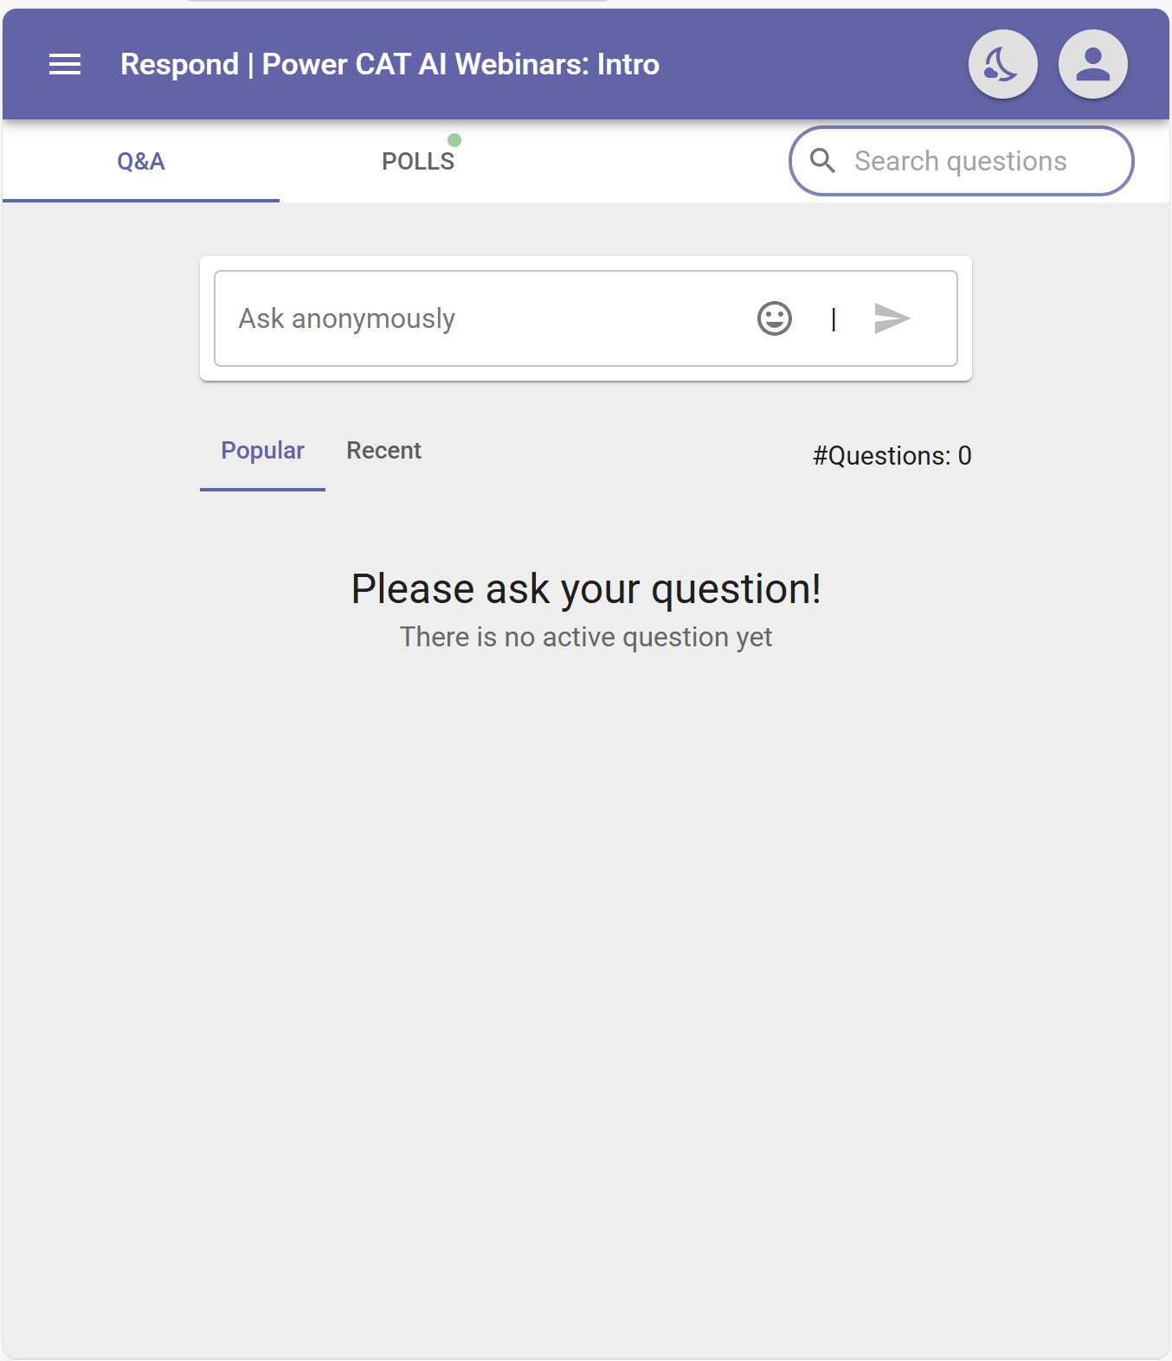
Q&A!
aka.ms/AiWebinars/Questions

Slide 43
Thank you for participating!

Slide 44

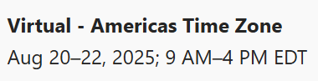


Intensive 3-day training, upcoming sessions
Register now at: aka.ms/CopilotStudioBootcamp

